Slide 1
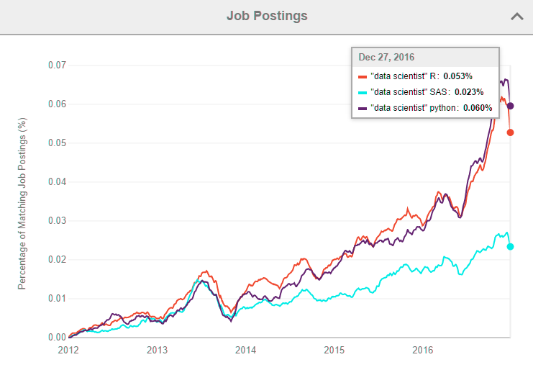
CHEMOINFORMATICS AND PYTHON
Having some knowledge in Python or R is important to landing a job

Slide 2
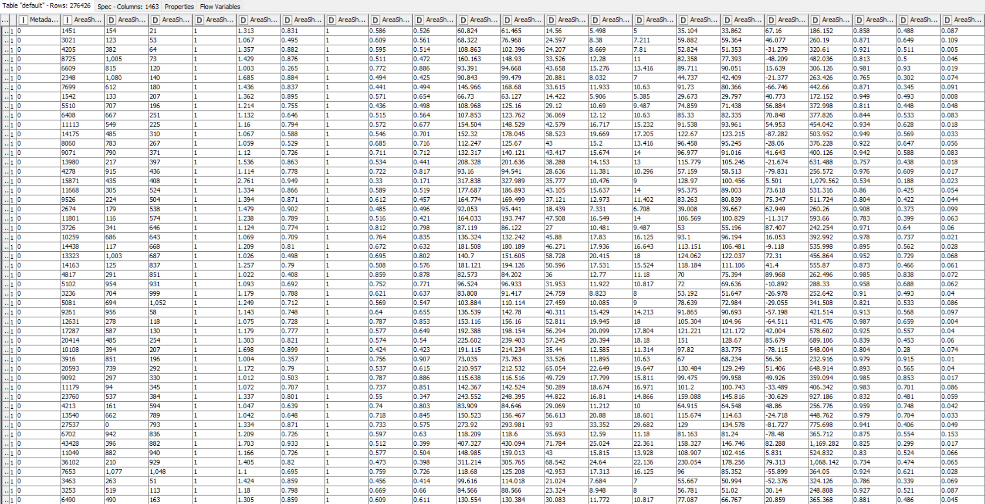
DATA (BIG DATA)
CONFIDENTIAL

Slide 3
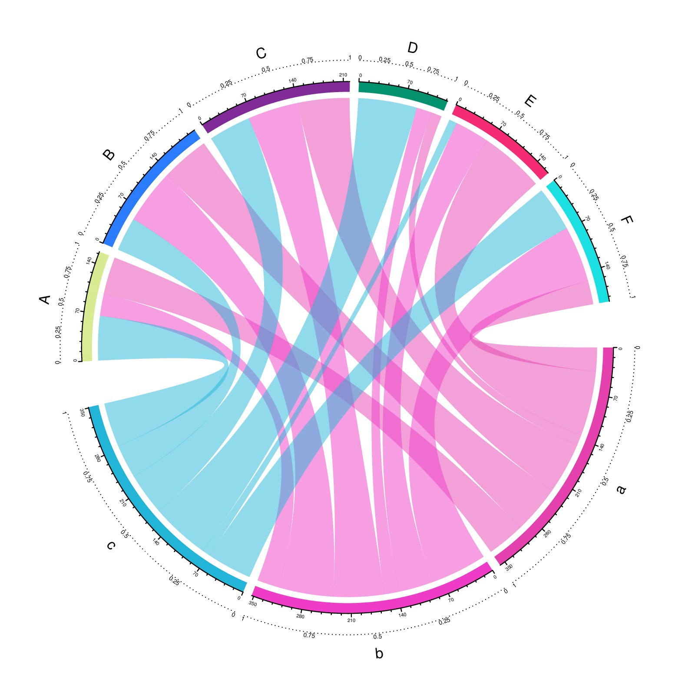
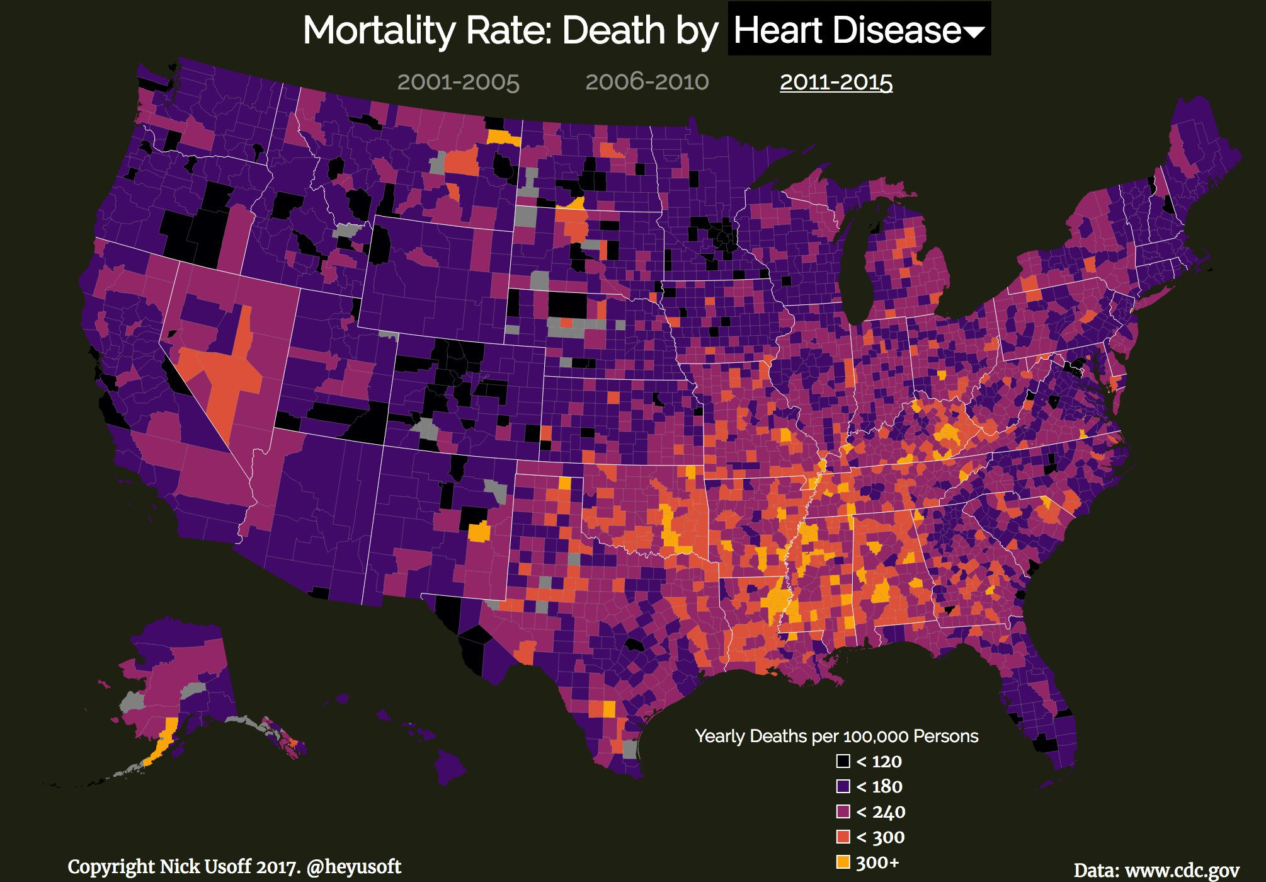
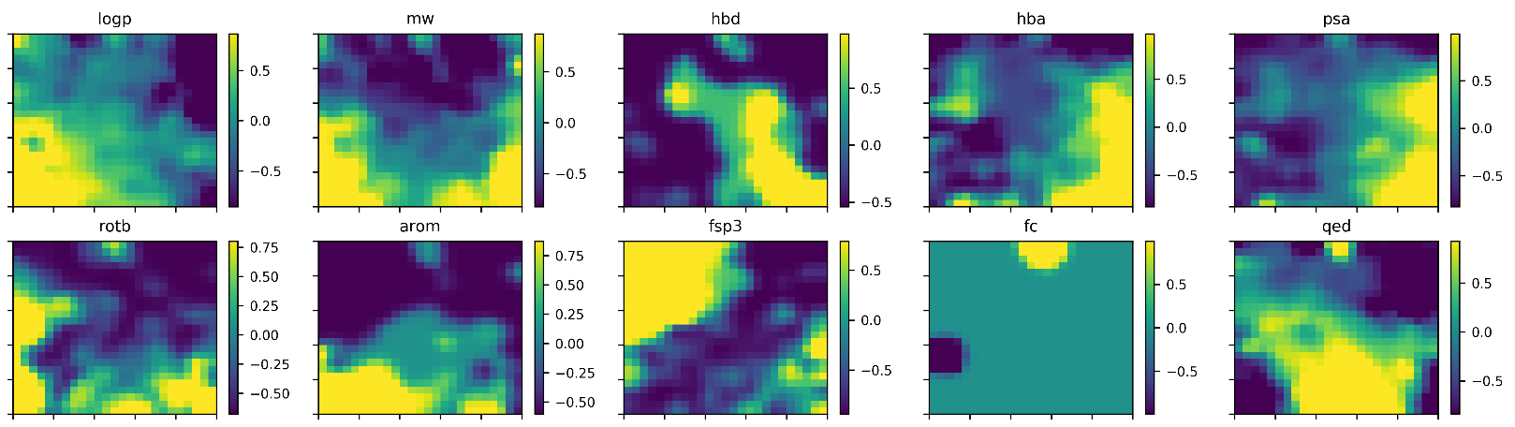
DATA VISUALIZATION

Slide 4
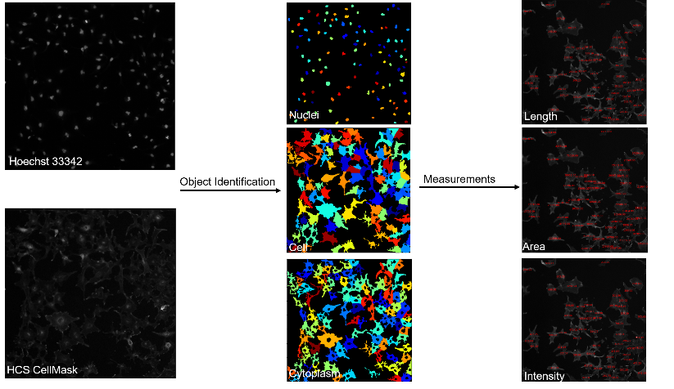
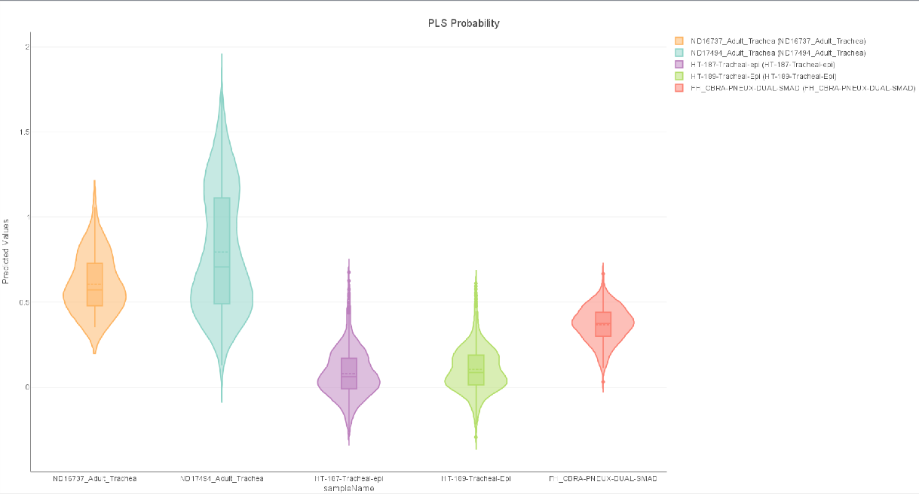
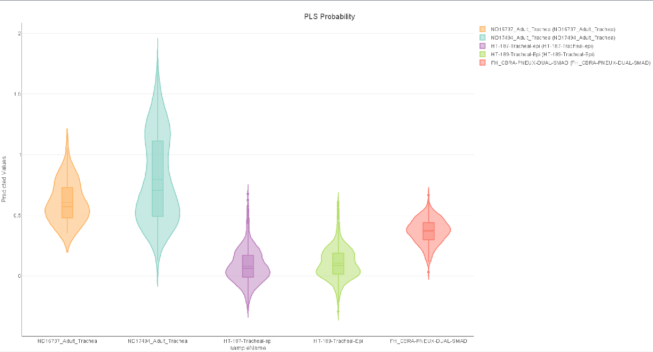
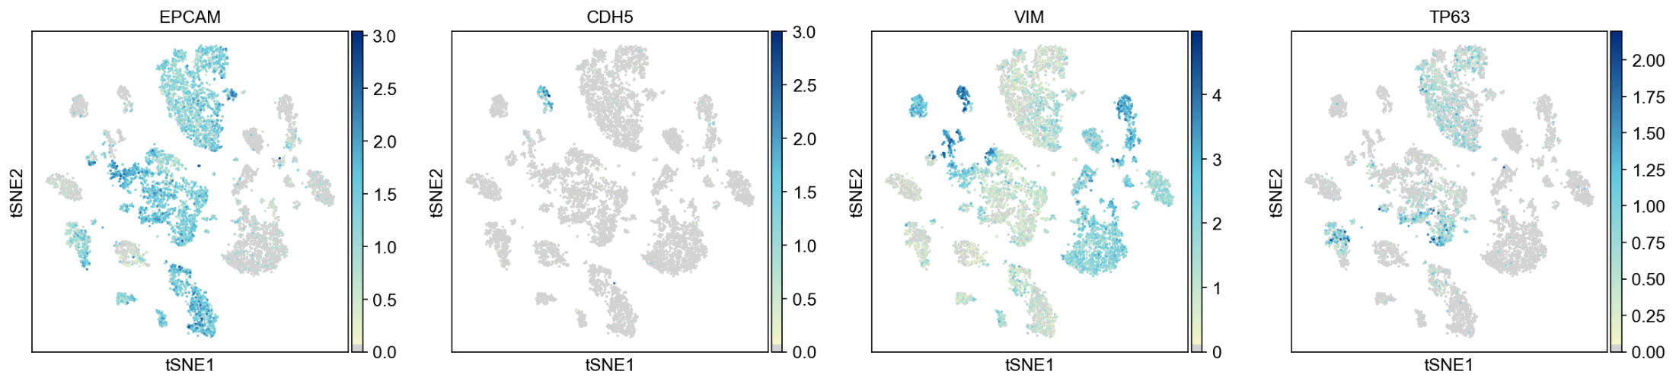
DATA ANALYSIS

Slide 5
PYTHON BASICS

Slide 6
What is Python?
From Wikipedia: Python “is an interpreted, high-level and general-purpose programming language.”

Slide 7
What is Google Colab
https://www.youtube.com/watch?v=inN8seMm7UI

Slide 8
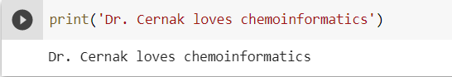
Prompt
Response

Slide 9
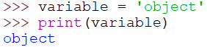
ASSIGNING OBJECTS
variable = object
Some types of objects:
Floating point (float) = 321.421, 231.31, 486.54
Integer (int) = 1, 2, 3, 4, 5
String (str) = ‘cat’, ‘dog’, ‘python’
List (list) = [1,2,3,4,5]
Dictionary (dict) = {‘hours’=24,’days’=365}
After assigning a variable an object, the variable is now “equivalent” to the object

Slide 10
DATA STRUCTURES
What is a data structure?
As the name implies, they are “structures” that hold data together (think columns in Excel)
They store a collection of related data
For example, you might have an excel file with the molecular weight of 100 molecules
To perform operations on this data, you must first read the data from the file and add it to a data structure.
Data structures make your life easier
There are four built-in data structures in python:
list, tuple, dictionary, and set
see: https://python.swaroopch.com/data_structures.html

Slide 11
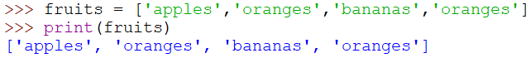
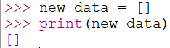
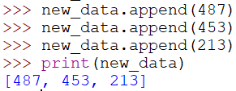
ASSIGNING LISTS
A list holds an ordered collection of items
You can hold a sequence of items in a list
Lists are enclosed in square brackets
You can create empty lists
This empty list can be used later to append new items into

Slide 12
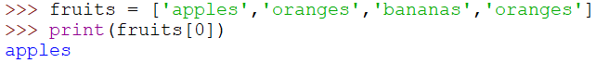
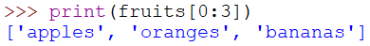
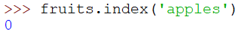
INDEXING LISTS
Python indexes items in a list beginning from 0
A range can also be indexed
Note: item 3 (‘oranges’) was not included
Inclusive [0:2] Exclusive
Obtaining index numbers
This is useful when you are working with a file which has headers

Slide 13
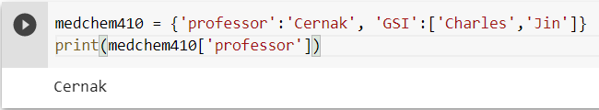
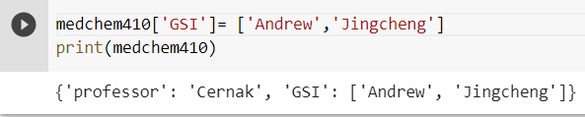
ASSIGNING DICTIONARIES
A dictionary holds an ordered collection of keys and values
Like a real dictionary, python dictionaries keep values for each key
Dictionaries are enclosed in curly brackets
Dictionary keys can be redefined with a new value
Notes:
Change to this year

Slide 14
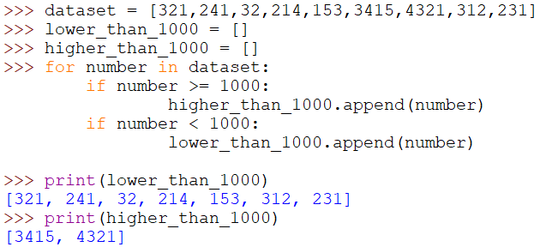
FILTERING DATA
For loops & if statements:

Slide 15
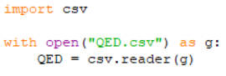
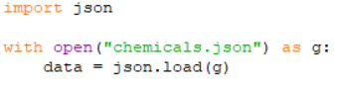
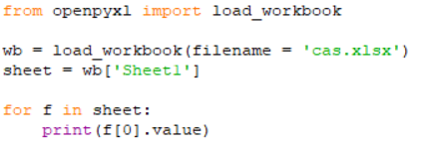
LOADING DATA
You will likely encounter data stored in several forms:
CSV – comma separated values
https://docs.python.org/3/library/csv.html
‘import csv’ at the top of your file
Stores lists of lists
JSON – javascript object notation
The most popular used data structure to send messages/information across the internet
‘import json’
https://docs.python.org/3/library/json.html
Can store lists and dictionaries in JSON
Excel - .xlsx files
Use openpyxl
‘from openpyxl import load_workbook’
https://openpyxl.readthedocs.io/en/stable/
Stores lists

Slide 16
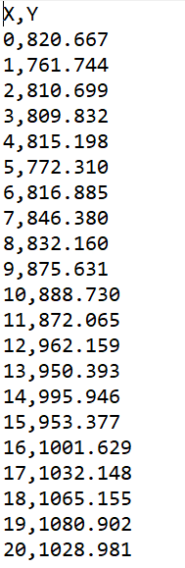
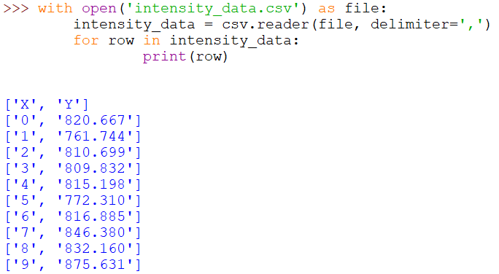
LOADING DATA - CSV
CSV File (intensity_data.csv) Loaded in Python

Slide 17
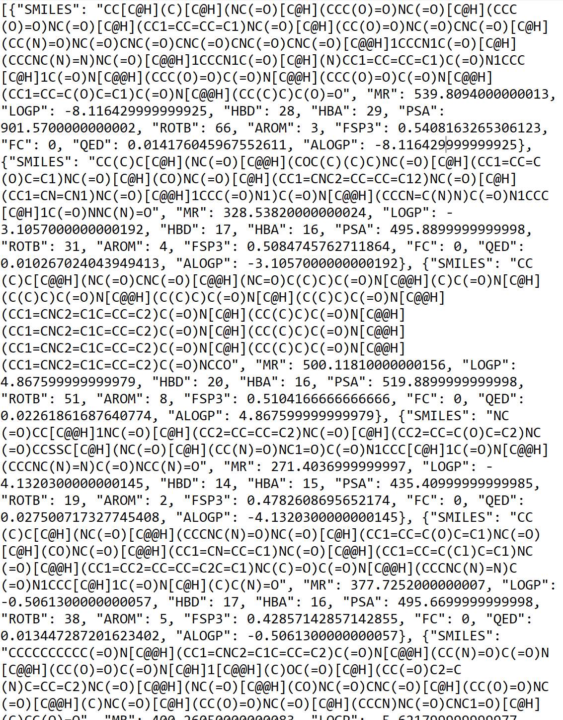
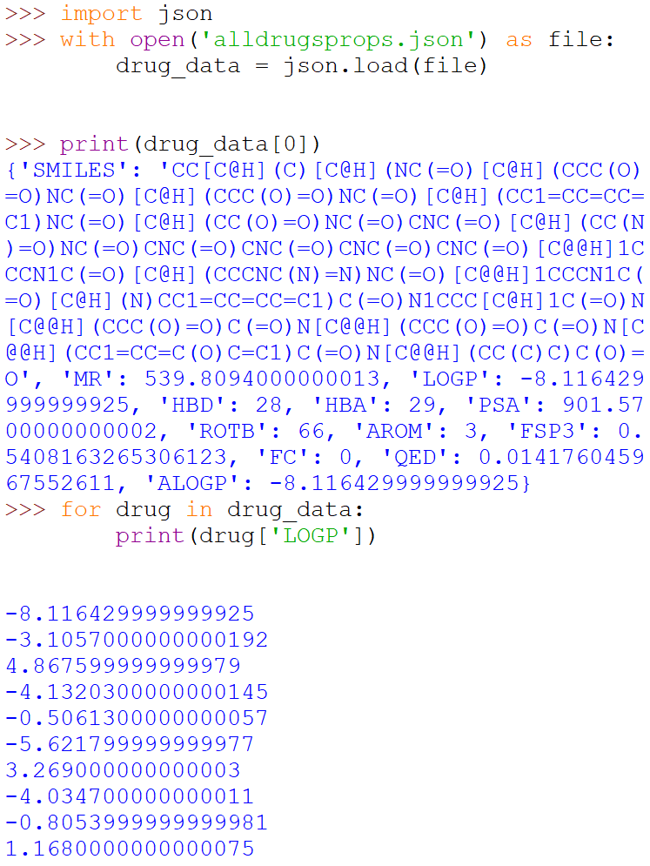
LOADING DATA - JSON
JSON File (alldrugsprops.json) Loaded in Python

Slide 18
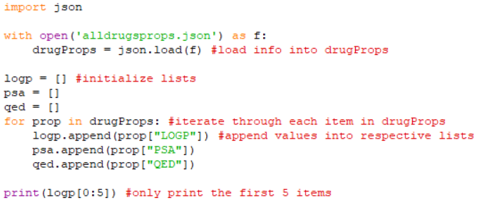
ALL TOGETHER

Slide 19
GETTING STARTED WITH PYTHON
Beginner Tutorials
Automate The Boring Stuff With Python - https://automatetheboringstuff.com/
R Swirl - https://swirlstats.com/
Coursera (available to U of M students)
Community
Stack Overflow – Online question and answer forum (like Yahoo! Answers)
Github – Sharing code
Good Packages to Learn
Python:
Plotly – making graphs
Sklearn – machine learning
Pandas – handling large datasets
R:
R Shiny – making graphs

Slide 20
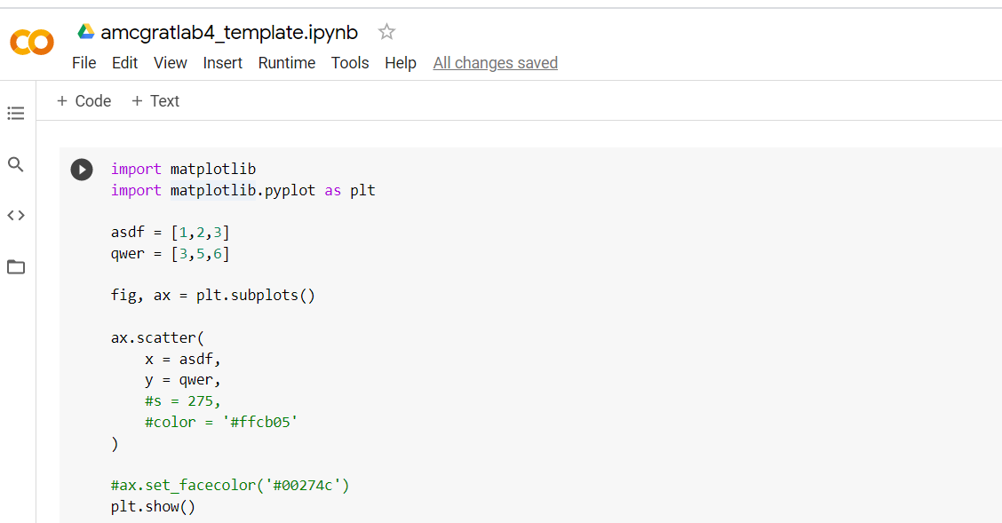
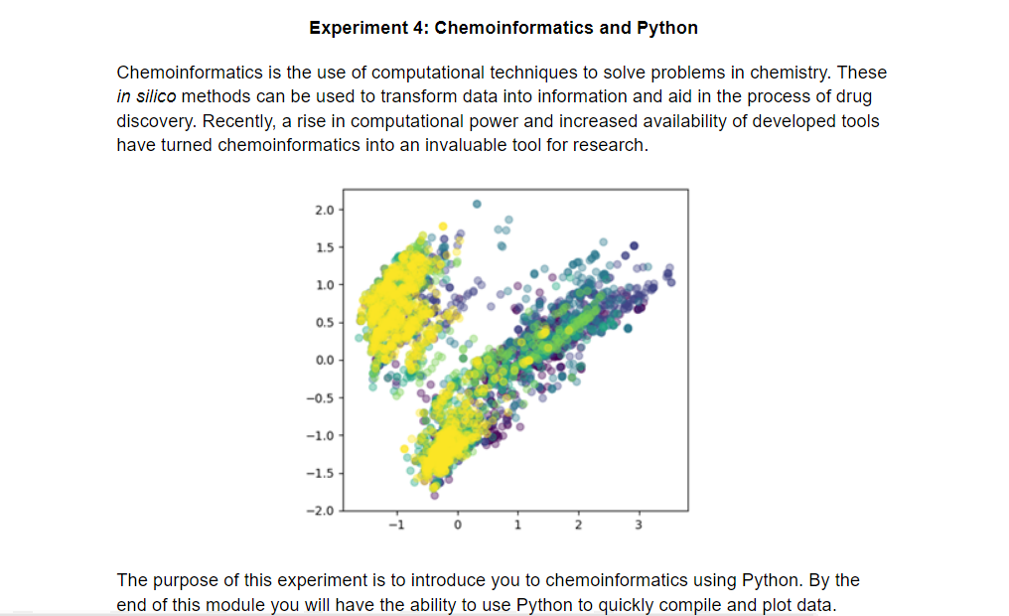
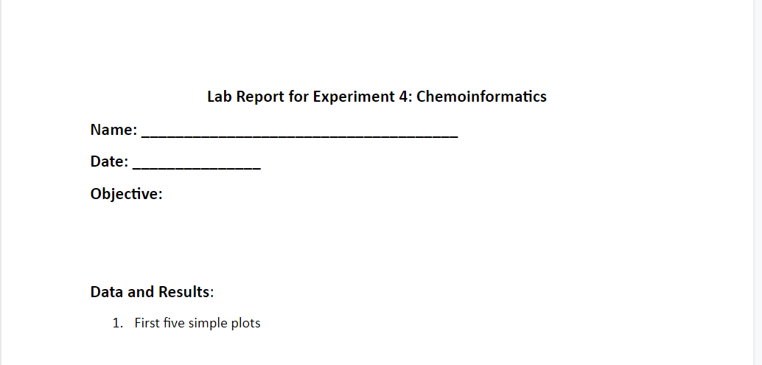
GETTING STARTED WITH LAB

